Slide 1
Logic, Conditionals, and Loops
Module 6

Slide 2
Conditionals

Slide 3
Booleans
Conditionals revolve around Boolean logic: essentially whether something is true or false, Yes or No, On or Off.
JavaScript Booleans only take true or false values, but can represent any of the logic mentioned.
Remember: All of our comparison operators return a boolean

Slide 4
“Truthy” Values
JavaScript attempts to coerce certain values to other types for comparison, like we saw with “10” == 10 being true
JavaScript also treats everything with a value as being “true”
Conversely, there are a whole range of values it treats as “false”

Slide 5
“Falsey” Values
The following values are treated as “false” by JavaScript:
+0 or -0
“” (Empty Strings)
Undefined and Null
NaN (Not a Number)
False (the Boolean value)

Slide 6
Comparisons
Conditionals require comparison, so we will need every comparison and logical operator we have learned so far
Comparison Operators:
===, ==, !==, !=, >=, >, <=, <
Logical Operators:
&&, ||, !

Slide 7
Conditionals
A conditional statement allows us to perform different actions based on whether a condition is true or false
Here are our conditional statements:
if(…) {…}
else if(…) {…}
else {…}

Slide 8
Conditional Statements
An if statement will execute a block of code if and only if a condition is true
An else if statement will execute a block of code only if the original if statement was false and another condition is true
An else statement will execute a block of code only if both the if statement and the else if statement were false

Slide 9
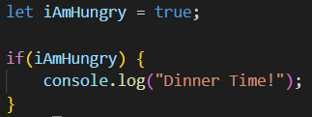
If Statements
We can write an if statement like this:
As long as the condition evaluates as true, the code will run

Slide 10
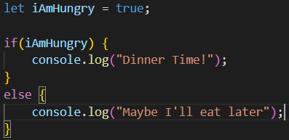
Else Statements
We write else statements like this:
Else statements will run only if the condition in the if statement was false
Else statements are optional

Slide 11
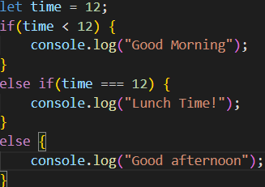
Else If Statements
We can create else if statements like this:
Else if will execute only if the first condition was false AND the second was true
You can only create an else if statement if you have already created an if statement

Slide 12
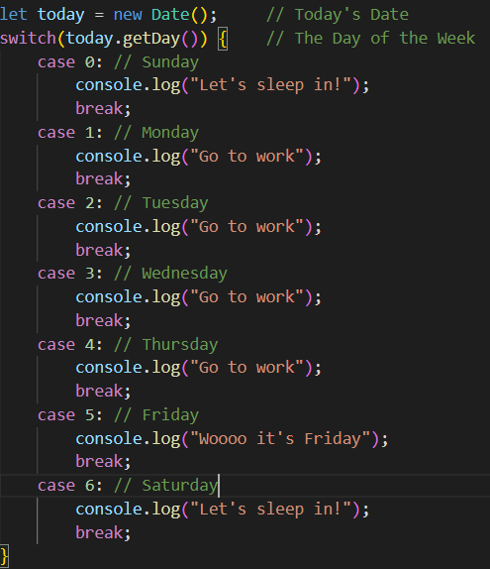
Switch Statements
A switch statement will execute one of many blocks of code depending on the value of the condition
Better to use when you have many conditions
If the condition is not met, it will not execute

Slide 13
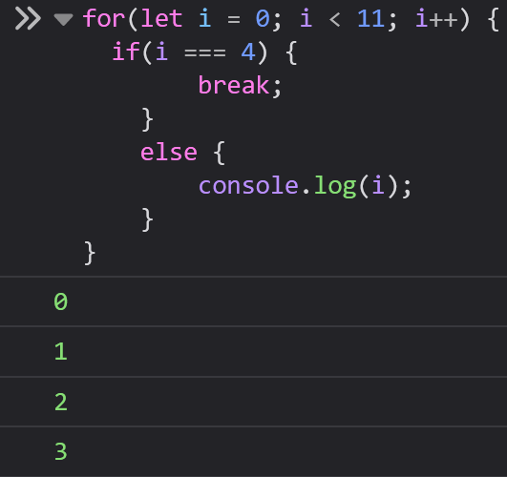
Break
The break keyword “breaks out of” a block of code
For a switch statement to function correctly, you must include a break or a return at the end of each block

Slide 14
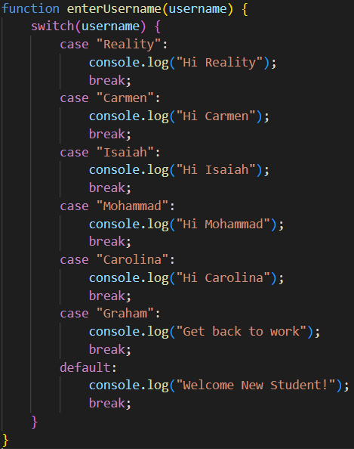
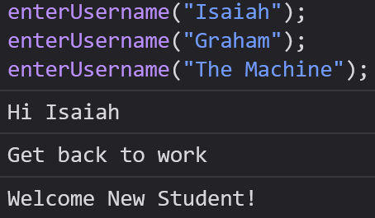
Default
The default keyword specifies a case of a switch statement to run if no other case is executed
We generally make the default our last case, but it will function perfectly fine regardless – this is just a convention
A default case is always optional - you can omit the default if you would like

Slide 15
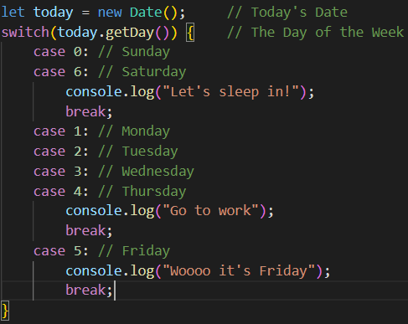
Shared Cases
Switch Statements allow multiple cases to execute the same block of code

Slide 16
Switch Statements
Sometimes your condition might satisfy multiple cases, but only the first case met will be executed
If there is no default, the switch statement will not execute any of the code blocks
Switch statements always use strict comparison ( === ), so you must match the value AND the type.

Slide 17
Loops

Slide 18
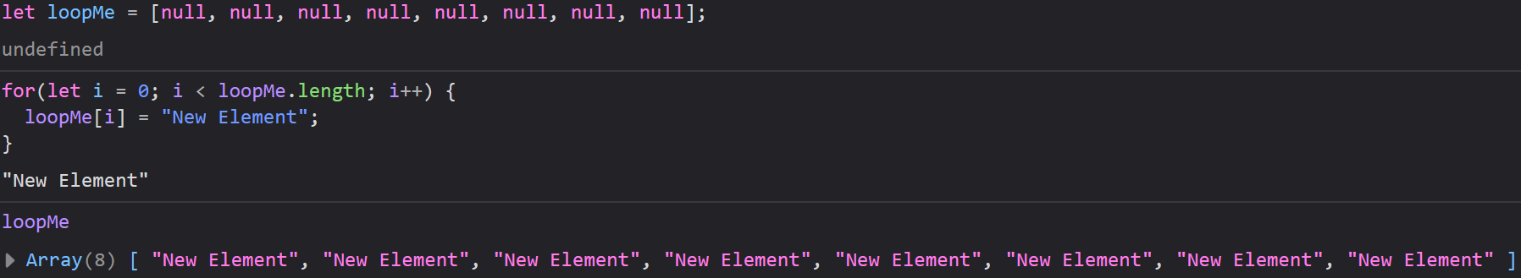
Loops
A lot of times we want to do the same thing to a whole bunch of items in an array, data structure, or even a webpage.
If we had an array and wanted to assign the String “New Element” to each value, it could take a long time to do that manually.
Instead, we can “loop” through each element and use the same line of code on each element

Slide 19
Types of Loops
JavaScript has 5 kinds of loops that fall into 2 categories
For Loops
for loop, for/in loop, and for/of loop
While Loops
while loop, and do/while loop

Slide 20
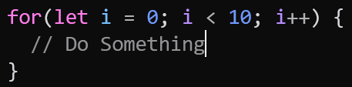
The For Loop
Programming classic that is available across all languages
Has three parts:
Initialization – A variable you create to keep track of where you are in the loop
Condition – A test that tells the loop how long to run
Incrementer/Decrementer – Increments the variable (i)

Slide 21
The For Loop
We initialize a variable i
Then check that i meets a condition
Then we increment i by one

Slide 22
The For Loop
i
loopMe
0
1
2
3
loopMe[0] = “New Element”
loopMe[1] = “New Element”
loopMe[2] = “New Element”
loopMe[3] = “New Element”

Slide 23
The For Loop
i
loopMe
4
5
6
7
loopMe[4] = “New Element”
loopMe[5] = “New Element”
loopMe[6] = “New Element”
loopMe[7] = “New Element”

Slide 24
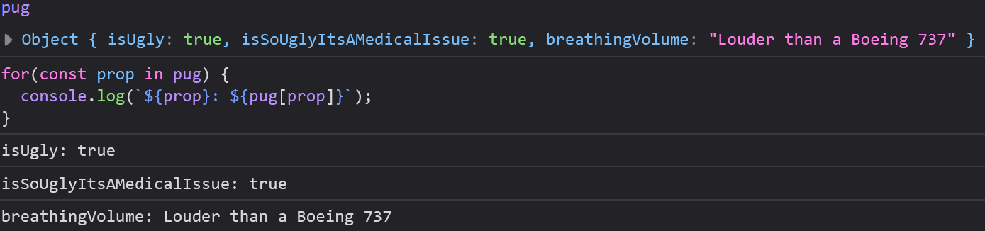
The For/In Loop
For/In Loops are used to loop through the properties of an object, which would be difficult to do with a standard for loop.
This kind of loop does not exist in all languages and is very nice for working with objects

Slide 25
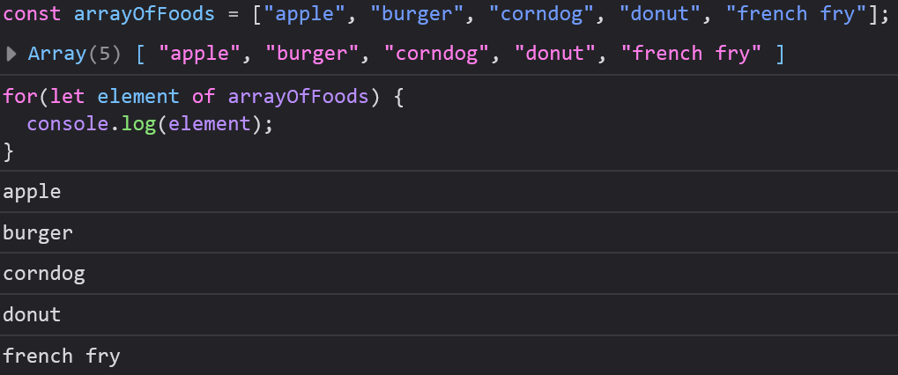
The For/Of Loop
Loops through the values of an iterable object, like an array, String, Map, etc
Must declare a variable as a parameter

Slide 26
For/Of Loops
For/Of Loops are Unique feature of JavaScript, introduced in ES6 (2015)
Does not require an index to use, which makes them very forgiving to work with.
Note: These are not your best choice for working with objects. We have another loop type for that.

Slide 27
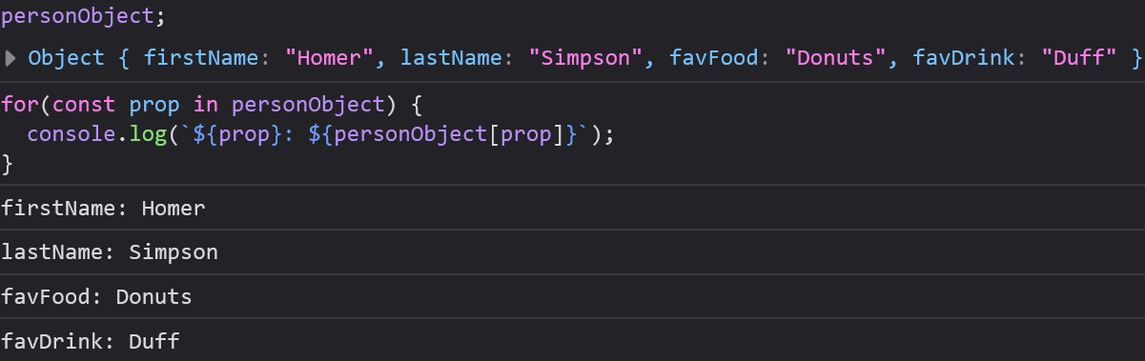
The for/in loop
Loops through the properties of an object
Must declare a variable to refer to properties (prop above)

Slide 28
For/In Loop
For/In Loops are the easiest way to loop through an object’s properties, but not the only way.
For and While loops are capable of this too, but have extra steps

Slide 29
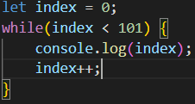
The While Loop
While loops loop through a block of code until a condition is true
Any variables needed to iterate through a while loop must be declared outside of the loop, unlike a for loop
If you forget to iterate your variable it will cause an infinite loop, which will crash your browser since it will not be able to execute commands outside of the loop

Slide 30
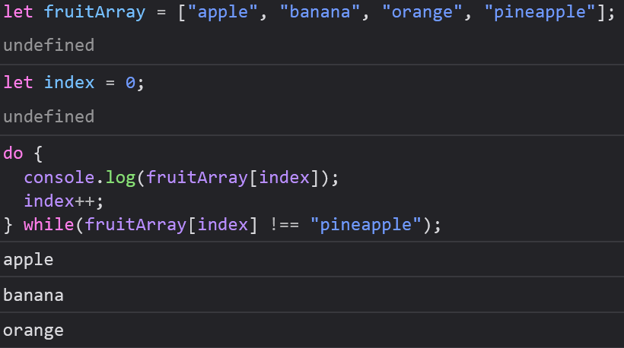
The Do/While Loop
Do/while loops work almost exactly like standard While loops with one key difference:
Do/while loops always execute at least once
The loop will continue running after its first iteration as long as the condition is true

Slide 31
O(n) Notation – big o
When we write complex programs, we need a way to measure how they perform.
Almost any solution will work on a small data set, but when the size of our inputs (like arrays, objects, lists, maps, etc) grow, they may not be the best solution
Big O Notation can measure the time or space complexity of our algorithms.

Slide 32
Common o(n) values
O(1) – Our algorithm takes the same amount of time to run regardless of input size (ideal, but rare)
O(log n) – Our algorithm’s time grows slowly as the input size grows (this is a phenomenal O(n) value, but not always possible)
O(n) – Our algorithm’s time grows proportionately to the input size (probably the most common O(n) value)

Slide 33
Common o(n) values
O(n log n) – Algorithm’s time grows slightly faster than O(n) as input size grows
O(n^2) – Algorithm’s time grows quadratically as the input size grows (this is not a very good O(n) value – at this point we should try to refactor)
O(n^3) – Algorithm’s time grows cubically as the input size grows (this is a very bad O(n) and will take very long to complete – at this point we should refactor our code)

Slide 34
Calculating O(n)
O(n) can be calculated Mathematically using limits, however no developer ever actually does calculus to find O(n).
As a short cut, we generally want to check how many operations our algorithm is performing.
If we wanted to read each element of an array which has a number of elements represented by n, it would take n operations, giving us O(n)

Slide 35
Using Loops
For and While loops are the most common loops you will use and they are mostly interchangeable
There might be situations where one loop could be easier to use than another, but you will always be able to solve the same issue with both.
For loops are generally easier for beginners since they never encounter infinite loops.

Slide 36
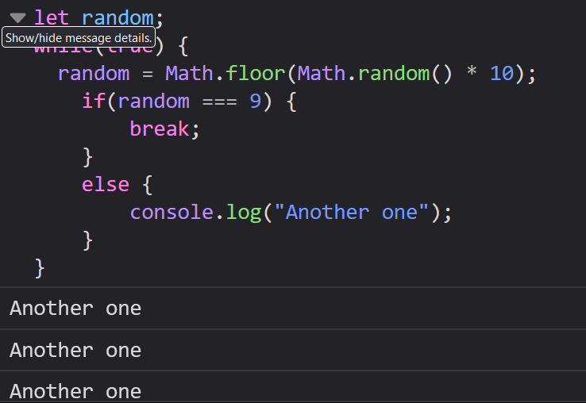
Escaping a Loop
You can always use break statement to exit a loop.
Especially when working with while loops, make sure you increment your iterator variable
Particularly in Web Development, a while loop that is not incremented properly is a pain and you’ll have to reopen your browser

Slide 37
Continue
As soon as the interpreter reads continue inside of a loop, it will skip the rest of the current iteration and move on to the next iteration
This can be useful if you want to skip an index or an iteration, however there is usually a better way to accomplish this
Continue statements can make code difficult to read, so use them sparingly

Slide 38
Labels
A label allows you to label a statement of your code and allows special interactions with break.
Normally a break is used to exit a loop or switch, but with a label it can exit any code block, like if, else, and class blocks.
Well it is good to know that labels exist, they are discouraged in all modern programming since they mimic goto statements, which are where the term “spaghetti code” comes from.

